Slide 1
IoT/M2M Standards, Legal and Regulatory work

Slide 2
Contents..
Executive Summary
IoT/M2M Predictions
Policy Initiatives & Standardization activities
Globally
In India
Communication Technologies
IoT/M2M Technologies in smart city mission
Conclusion

Slide 3
What is IoT / M2M
IoT/M2M Definitions

Slide 4
Scope of IoT / M2M
IoT is the next big thing
India forecasted to grow into a hub for IoT Solutions
Market value predicted to reach USD 9 billion by 2020
Sensor networks, RFID, M2M, mobile Internet, wired & wireless communication network etc.
In wireless communication Wi-Fi, ZigBee, 6LOPAN, Bluetooth technologies etc. for short range connectivity
GSM 2G/ 3G/ LTE/ Wi-Max etc. to connect M2M gateway to the desired server.
Standards, legal and regulatory;
Securing of internet of things and
Privacy issues are key challenges .
To improve functionality – cost-quality trade-offs to be made
3GPP, ETSI, oneM2M, IEEE, ITU and ISO/IECJTC1 etc. provide recommendations and standards.
Market
Technologies
Challenges
Standardization

Slide 5
IoT/M2M Predictions
Research Nester: Global IoT market reached USD 598.2 Billion in 2015 and expected to reach USD 724.2 Billion by 2023.
Juniper: Number of connected IoT devices, sensors and actuators are expected to reach over 46 billion by 2021.
Machine Research: CAGR of 16% i.e IoT connections to grow from 6 billion in 2015 to 27 billion in 2025
Cisco: IP networks to support 10 billion new devices/connections, increasing from 16.3 billion in 2015 to 26.3 billion by 2020.
Gartner: 8.4 Billion Connected "Things" Will Be in Use in 2017, Up 31 % from 2016.
IDC: Global IoT Spending is expected to reach $1.29 trillion at CAGR of 15.6% over 2015-20.

Slide 6
IoT/M2M Global Policy Initiatives

Slide 7
Global Policy Initiatives
GSMA: IoT Device Connection Efficiency Guidelines on how machines should communicate via the mobile network in the most intelligent and efficient way.
European Commission: Legislation and Policy Document on harmonization of standards & Policy across Europe on IoT/M2M and ICT Technologies
Com(2016) 176: ICT Standardisation Priorities for the Digital Single Market
To ensure that all these devices in the future will be able to connect and share data with each other
To guarantee a fresh approach to standards in the following domains: 5G, IoT, Cybersecurity, Cloud and Big Data.
To ensure that all forces in Europe pull in the same direction, using standardisation as a strategic instrument to EU industrial policy
Com(2016) 180: Digitising European Industry - Reaping the full benefits of a Digital Single Market
To establish a framework for coordination between national and EU-level initiatives in DSM technologies and public services modernisation package and relevant policy actions including investments and infrastructure, accelerating the development of ICT standards, exploring regulatory conditions and adaptation of the workforce, including up-skilling.

Slide 8
Global Policy Initiatives
SWD(2016) 110/2: Advancing the Internet of Things in Europe
This document is part of "Digitising European Industry (DEI)" initiative and specifies EU's IoT vision which is based on three pillars:
A thriving IoT ecosystem
A human-centred IoT approach
A single market for IoT.
Com(2009) 278: Internet of Things — An action plan for Europe
This paper deals with the wider policy initiatives related to the Lisbon strategy and with the current thinking on post-i2010 initiatives
BEREC BoR (16)39, Report on enabling the Internet of Things
In view of Digital Single Market (DSM) review, BEREC considers that, no special treatment of IoT services and/or M2M communication is necessary, except for the following areas:
Roaming;
Switching;
Number portability.

Slide 9
M2M/IoT Global Standardization Activities

Slide 10
Global Standardization Forums/Organizations
Main forums/ organizations:
European Telecommunications Standards Institute (ETSI)
IEEE
International Telecommunication Union (ITU)
Advancing open standards for the information society (OASIS)
ISO/IEC JTC 1
OneM2M etc. provide recommendations and standards.
Additional forums/organizations
Continua
GlobalPlatform
HGI (Home Gateway Initiative)
The New Generation M2M Consortium – Japan
OMA (Open Mobile Alliance) and over 200 member organizations.
The Internet Engineering Task Force (IETF) ROLL
3rd Generation Partnership Project (3GPP)
OIC
World Wide WEB Consortium (W3C)
Open Geospatial Consortium (OGC)
BBF (Broadband Forum)

Slide 11
European Telecomm. Standards Institute (ETSI)
ETSI TC on M2M responsible for developing standards and provide end-to-end view of M2M standardization.
Main areas of standardization at ETSI related to M2M issues are;
Data Security
Data Management
Data Transport
Data Processing
ETSI specialist task Force (STF 505) published technical reports covering IoT standards:
ETSI TR 103375,SmartM2M; IoT Standards landscape and future
Analysing the standards landscape provides a lot of existing standardised technology suggested for reuse by the Large Scale innovation Pilots (LSPs).
ETSI TR 103376, SmartM2M; IoT LSP use cases and standards gaps
Identifying technical standards / societal/ business gaps as a good indication of the level of maturity of standardization in a given vertical domain.
3rd Generation Partnership Project (3GPP): In 3GPP M2M is also called machine-type communications (MTC), work carried out on optimization of access and core network infrastructure, allowing efficient delivery of M2M services.

Slide 12
Institute of Electrical and Electronics Engineers (IEEE)
IEEE has existing standards, projects in development, activities & events related to growth of IoT/ M2M
Published Standards:
IEEE P2413, Draft Standard for an Architectural Framework for the Internet of Things : To promote cross-domain interaction, aid system interoperability and functional compatibility, and further fuel the growth of the IoT market
IEEE P2418 Standard for the framework of Blockchain use of Internet of Things: To address scalability, security and privacy challenges with regard to blockchain in IoT
IEEE P1451-99-Standard for harmonization of Internet of things Devices and Systems: To provide significant cost savings and reduce complexity, and offer a data sharing approach leveraging current instrumentation and devices used in industry.
IEEE P1931.1 standard for an Architectural Framework for Real Time Onsite Operations Facilitation (ROOF) for Internet of things: interoperability, collaboration and autonomous operation of an IoT system with computing required for context building, security, access control, data storage, data aggregation and ability to choose different cloud and application service providers.

Slide 13
OneM2M
Global standards initiative, covers requirements, architecture, API specifications, security solutions & interoperability.
Global Partnership:
8 ICT standards bodies: ARIB (Japan), ATIS (U.S.), CCSA (China), ETSI (Europe), TIA (U.S.), TSDSI (India), TTA (Korea), and TTC (Japan),
6 global fora and SDOs: (Broadband Forum, CEN, CENELEC, Global Platform, Next Generation M2M Consortium, OMA) and
Over 200 companies from all industrial sectors
Release 1 : Published in Jan 2015
Includes specifications covering requirements, architecture, protocols, security, and management, abstraction and semantics
Provides sufficient building blocks to enable M2M and IoT applications to interwork with each other
Release 2 : Published in August 2016
Includes semantic interoperability and testing specifications

Slide 14
International Telecommunication Union (ITU)
Established various focus groups to develop recommendation relevant to M2M
Focus Groups on:
Smart Sustainable Cities(FG SSC);
Smart Water Management(FGSWM);
Disaster Relief Systems, Network Resilience and Recovery (FG-DR&NRR);
Smart Cable Television (FG Smart Cable);
M2M Service Layer (FG M2M);
Focus Group “From/In/To Cars Communication” (FG Car Com);
Smart Grid (FG Smart);
Cloud Computing (FG Cloud)etc.

Slide 15
ISO/IEC JTC 1
Joint Technical Committee (JTC) constituted jointly by
International Organization for Standardization (ISO) &;
International Electrotechnical Commission (IEC)
ISO/IEC JTC 1 WG 10 (IoT): developing ISO/IEC 30141-IoT reference architecture.
WG 10 work areas:
Terms and definitions for JTC 1 IoT Vocabulary (ISO/IEC 20924).
IoT reference architecture which is flexible and easily extended to various types of applications (ISO/IEC 30141).
Support for interoperability of IoT systems in terms of framework, networking, syntactic and semantic interoperability (ISO/IEC 21823-1).

Slide 16
IOT/M2M Policy Initiatives: India

Slide 17
Department of Telecommunication (DoT)
Released M2M roadmap covering:
M2M communication
M2M Numbering Plan.
QoS aspects.
Roaming requirements.
M2M Service Provider (MSP) registration process.
KYC, SIM Transfer, International roaming etc.
spectrum requirements.
frequency bands
Product Certification process.
Pilot projects.
Capacity building.
Center of Innovation
M2M entrepreneurs
Draft M2M Service Providers Registration Guidelines Covering:
Terms & Conditions for M2MSP Registration
Technical Conditions for M2MSP Registration
Security Conditions and a provision

Slide 18
Ministry of Electronics & Information Technology
IoT Policy
Vision:
To develop connected and smart IoT based system
Objectives:
To create an IoT industry in India
Capacity development (Human & Technology) for IoT
Create specific skill-sets for domestic & intl markets.
To undertake R&D for all assisting technologies.
Develop IoT products specific to Indian needs
Policy framework of IoT Policy proposed to be implemented via a multi-pillar approach

Slide 19
Telecom Regulatory Authority of India (TRAI)
Released CP on ‘Spectrum, Roaming and QoS related requirements in M2M communications.
Addressing questions around
Regulatory Licensing framework
What should be the quantum of spectrum required to meet the M2M communications
Roaming
SIM/eUICC
Security etc.
Recommended delicensing of V-band (57-64GHz).

Slide 20
Institute of Engineering and Technology (IET)
IET IoT Panel
Global Advisory Board and Core Panel
Horizontal: Standards, Legal & Regulatory, Skill Development & Social Impact
Vertical: Telecom, Energy, Healthcare, Smart living, Smart Transportation , Smart Agriculture, and Ganga Rejuvenation

Slide 21
IoT/M2M Standardization Activities in India

Slide 22
Standardization Forums/Organizations
Main Forums/Organizations
Bureau of Indian Standards(BIS)
Telecommunication Engineering Center(TEC)
Telecommunication Standards Development Society, India (TSDSI)

Slide 23
Bureau of Indian Standards (BIS)
National Standards Body of India
BIS Panel on ICT New & Emerging Technology
Panel 1: Title–Internet of Things (IoT), monitoring work carried out at ISO/IEC/JTC1 WG 10 covering IoT, Big Data, Sensor network and Wearable devices. Panel work has now been transferred to LITD TC
Panel 2: Title–Smart Infrastructure, monitoring work carried out at ISO/IEC/JTC1 WG 11 covering Smart Cities (ICT Technology), Active Assisted Living, Smart manufacturing, and Smart Energy.

Slide 24
Telecommunication Engineering Center (TEC)
TEC is the engineering wing of DoT
TEC M2M/ IoT TRs covering:
Gateway & Architecture
Power Sector
Automotive (Intelligent Transport System) Sector
Remote Health Management
Safety & Surveillance Systems
ICT deployment and strategies for India’s Smart Cities: A Curtain Raiser
Number resource
V2V / V2I Radio communication and Embedded SIM
Spectrum requirements for PLC and Low power RF communications

Slide 25
Telecommunication Standards Development Society, India (TSDSI)
Government recognized body
TSDSI WG on IoT/M2M published report covering Indian Use cases:
For Utilities-V0.2.0-20151003 advance for NWG
For Environment Pollution Monitoring & Control
For SmartCities-V0.2.0-20151003 advance release for NWG20
For Smart Governance -V0.2.0-20151003 advance for NWG
For Remote Asset Management-V0.2.0-20151003 advance for NWG
On Smart Villages V0.2.0-20151003 advance release for NWG
For Transportation V0.2.0 20151003 advance for NWG
On Industrial Automation V0.2.0-20151003
On Smart Homes V0.2.0-20151003 advance release for NWG
On Health V0.2.0- 20151003 advance for NWG

Slide 26
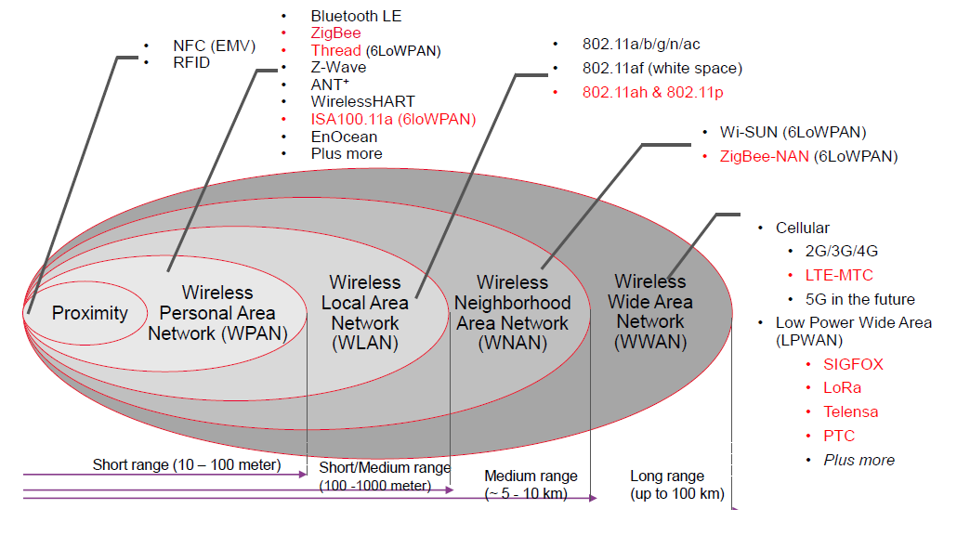
IoT/M2M Communication Technologies

Slide 27
IoT/M2M Technologies in Smart City Mission
Top five technologies
M2M Technologies
Data Security
New Storage Technologies
Technologies for Renewable Energy
Disaster Management Technology

Slide 28
Conclusion
IoT making the world more agile and functional via M2M and other protocols i.e. MQTT, CoAP, OMA LWM2M etc.
M2M represents a developing field with its own concepts that include sensors, communications in local-area and wide-area, server on premises, local scanning devices, user-facing services, and storage and analytics
Strong market case for producing global speci­fications
M2M provides business opportunities for new devices and services.
Need for common global standards to reduce complexity, facilitate roll-out of new devices & services, to provide economies of scale
Many commercial deployments already in place i.e.[OCEAN, IOTDM, OM2M, CDOT, HP etc.] as PoC for industry to accelerate take up of IoT products and platforms

Slide 29
Thank you…

