Slide 2
Agenda
EU Project SESEI
5G Standards
  The why, when, where, what and how
Conclusion

Slide 3






Project is a permanent presence in India
    SESEI (Seconded European Standardization Expert in India) is a face for the European standardization community in India
Why SESEI: India is a major trade partners for Europe, Increasing role of standards to gain market access and Evolving & complex national regulatory and standardization landscapes
Sector: 1. ICT: M2M/IoT, Security, 5G, NFV/SDN, e-Accesibility, eHealth, eCALL… 2. Electrical equipment including Consumer Electronics: Smart Grid, Smart Meter, LVDC, Micro- Grid, Lift Escalator… 3. Automotive: Connected Cars, ITS, e-Mobility… 4. Smart Cities: Mobility, Waste, Energy, ICT..
    www.sesei.eu , www.sesei.in , www.eustandards.in
Notes:
HG

Slide 4
5G Standards
The why, when, where, what and how

Slide 5

Why?

Slide 6


The Economic and Political needs for 5G
OECD (Committee on Digital Economic Policy) has stated clear objectives for 5G:
  Increasing GDP
  Creating employment
  Digitizing the economy
European Commission (Digital Single Market) also sets clear objectives for 5G:
  Digital Transformation of Industry
  Maximising economic growth
Note: These aims will only be achievable if 5G is designed
such that it meets the requirements of all industry sectors

Slide 7
The Technical Needs for 5G
Existing 3GPP technologies are capable of meeting todays needs, but:
  First LTE networks were deployed 8 years ago
  Data consumption continues to grow as consumers make more use of mobile broadband services
  The “Internet of Things” will result in billions of connected devices
  New (and unforeseen) users of 3GPP technologies continue to emerge (e.g., public safety and automotive)
  There is a constant demand to improve spectrum and energy efficiency and to leverage the benefits of modern research
It takes several years to design and build a next generation system (and even longer to obtain spectrum)
Key takeaways
There are economic, political and technical needs for 5G
Existing technologies are capable of satisfying today’s requirements but not those of tomorrow
It takes a long time to design and build a next generation system

Slide 8

What?

Slide 9
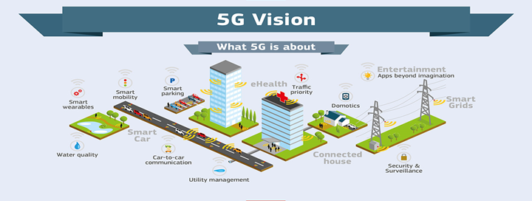
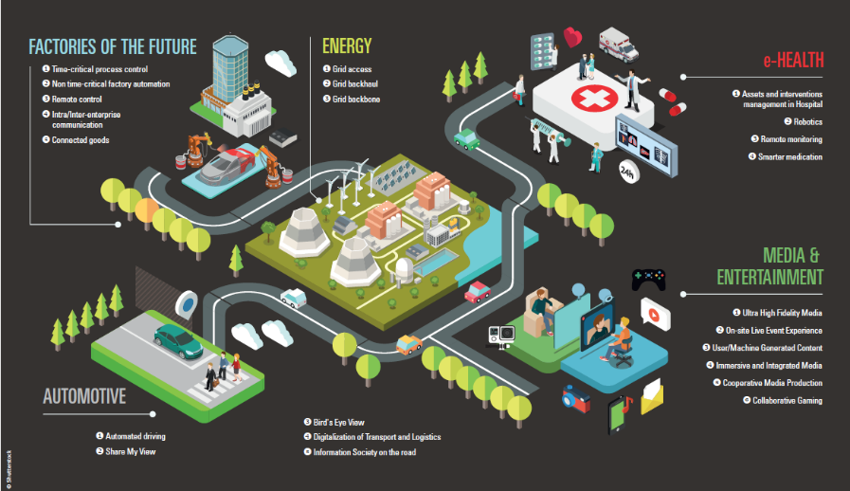
Much more that just people…
Key takeaways
5G:
is not really about connecting people, but more about connecting things
has widely varying use cases
has widely varying performance requirements
No single technology will satisfy all of these requirements
These requirements will not all be met at the same point in time
Transport Healthcare
Utilities,
Agriculture
Aviation
Education Entertainment Factory automation
etc

Slide 10
The three high level 5G use case families
Enhanced Mobile
Broadband
Massive Machine Type
Communications
Ultra Reliable and
Low Latency
Communications
Source: ITU-R

Slide 11
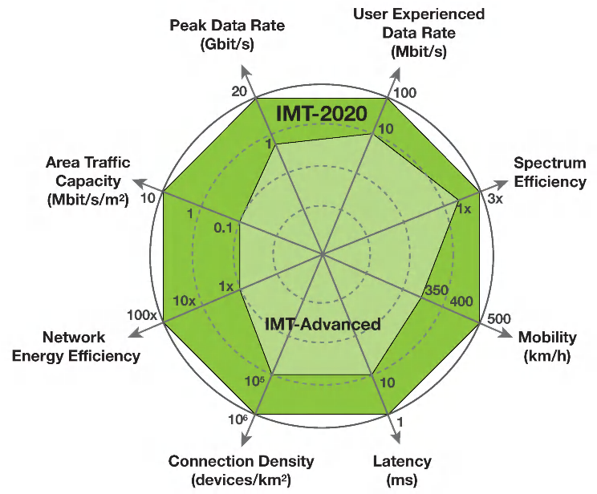
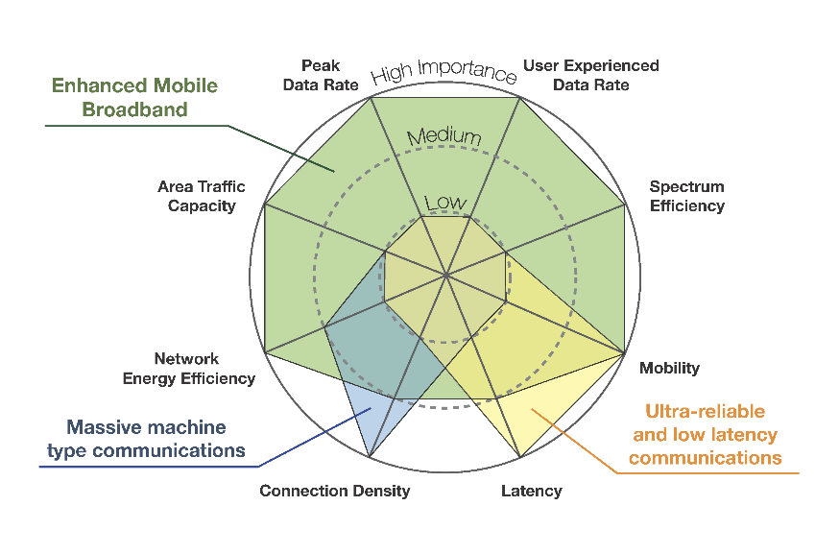
Performance Requirements
Key takeaways
To meet these requirements, 3GPP will specify:
a new radio interface (NR)
an evolved LTE radio interface
a new core network (NextGen)
An evolved LTE core network (EPC)
Use Case order of priority:
First: Enhanced Mobile Broadband and some Ultra Reliable/Low Latency functionality
Later: Massive Machine Type communications and more comprehensive Ultra Reliable/Low Latency functionality
Enhancement of key capabilities
from IMT-Advanced to IMT-2020
The importance of key capabilities in
different usage scenarios
Source: ITU-R M.2083

Slide 12

Where?

Slide 13


















3GPP specifying a complete 5G system
Developing internet protocol specs
Developing Recommendations
Referring to specs
ITU-R/T
Developing Mobile application specs
Cross reference of specs
Cross reference
Requirements
3GPP Market
Partners
Reference to 3GPP specs
Terminal certification based on 3GPP specs
Partners referring to 3GPP specs for the local use
EU
Japan
Korea
China
North America
India

Slide 14
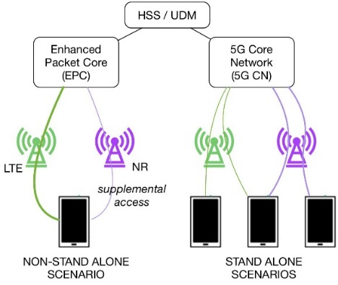
Where are we now?
5G NR (new radio) completed ahead of schedule
  The specification of 5G NR completed in December 2017, 6 months ahead of schedule, at the request of those players that wished to deploy 5G early (in non-standalone mode)
  The remainder of 5G Phase 1 (including Next Generation Core Network) on schedule to be completed by June 2018 (enabling deployment in standalone mode)
...but how was that possible?
  3GPP Working Groups saw a large increase in experts participation (more than 600 experts present in some working group meetings)
  During 2017, 3GPP processed 100 000 input contributions during 75 000 delegate/days of meetings
  This represents an unprecedented effort from the whole industry….

Slide 15
ETSI: 5G building blocks
ETSI is working significantly on 5G building blocks:
  Network Functions Virtualization (ISG NFV)
  Open Source MANO (OSG OSM)
  Mobile Edge Computing (ISG MEC)
  Millimetre Wave Transmission (ISG wWT)
  Next Generation Protocols (ISG NGP)
  Mobile/Broadcast Convergence (ISG MBC)
  Zero touch network & Service Management (ISG ZSM)
..as well as existing activities, e.g.:
  Use of whitespace spectrum, Spectrum Sharing (licensed and unlicensed) (TC RRS)
  Quantum Safe Cryptology (ISG QSC)
  Energy Efficiency (TC EE)
  Use of Satellites in 5G (TC SES)
…and many more
Key takeaways
There will be many contributors to the 5G standard, it cannot all be done in one place
ETSI is already developing significant building blocks which will form cornerstones of 5G
3GPP is specifying a complete 5G system description, using building blocks from other SDOs where appropriate
  - TSDSI : 5G HLF TFs

Slide 16


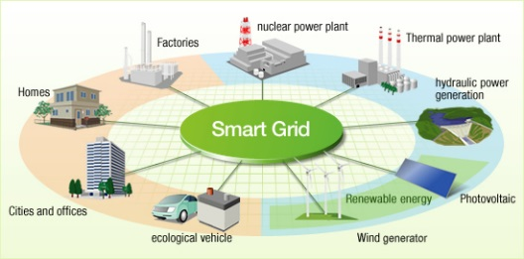



Is it just the same old faces?
3GPP Members now include, for example:
  Agricultural machinery manufacturers (e.g., John Deere, Husqvana, etc)
  Automotive manufactures (e.g, Volkswagen, Volvo, Toyota)
  Rail (e.g., Internationale Union of Railways)
  Factory Automation companies (e.g., Siemens)
  Energy Sector (e.g., Legrand)
  Environment (e.g., Veolia)
  Broadcasting Community (e.g., EBU, BBC, TDF)
  Satellite Community (e.g., ESO, Inmarsat)
  Aerospace (e.g., Lockheed Martin, BAE)
  Retail Sector (e.g., Alibaba)
  Social Media (e.g., Facebook)
  Advertising (e.g., Google)
  Full listing available here:
  http://www.3gpp.org/about-3gpp/membership

Slide 17

Is it really an International Standard?
Participation in 3GPP, 569 member companies in 43 countries from:
  Africa
  Asia (especially China, India, Japan and Korea)
  Australia
  Greater Europe
  North America

Slide 18

When?

Slide 19

When will 5G be ready?
2020 is the headline date for 5G
This date has been chosen more for political rather than technical reasons
It is also happens to coincide with the Olympic Games in Japan, July 2020
However, there is a push to bring the date forward because of:
  Mobile Operator rush “to be the first”
  Winter Olympic Games held in Korea, February 2018 showcased 5G
  Rugby World Cup to be held in Japan, September 2019
5G Open Trial Specification Alliance formed by SK Telecom, KT, NTT DoCoMo and Verizon:
  To speed up deployment & To meet the early deployment objective

Slide 20
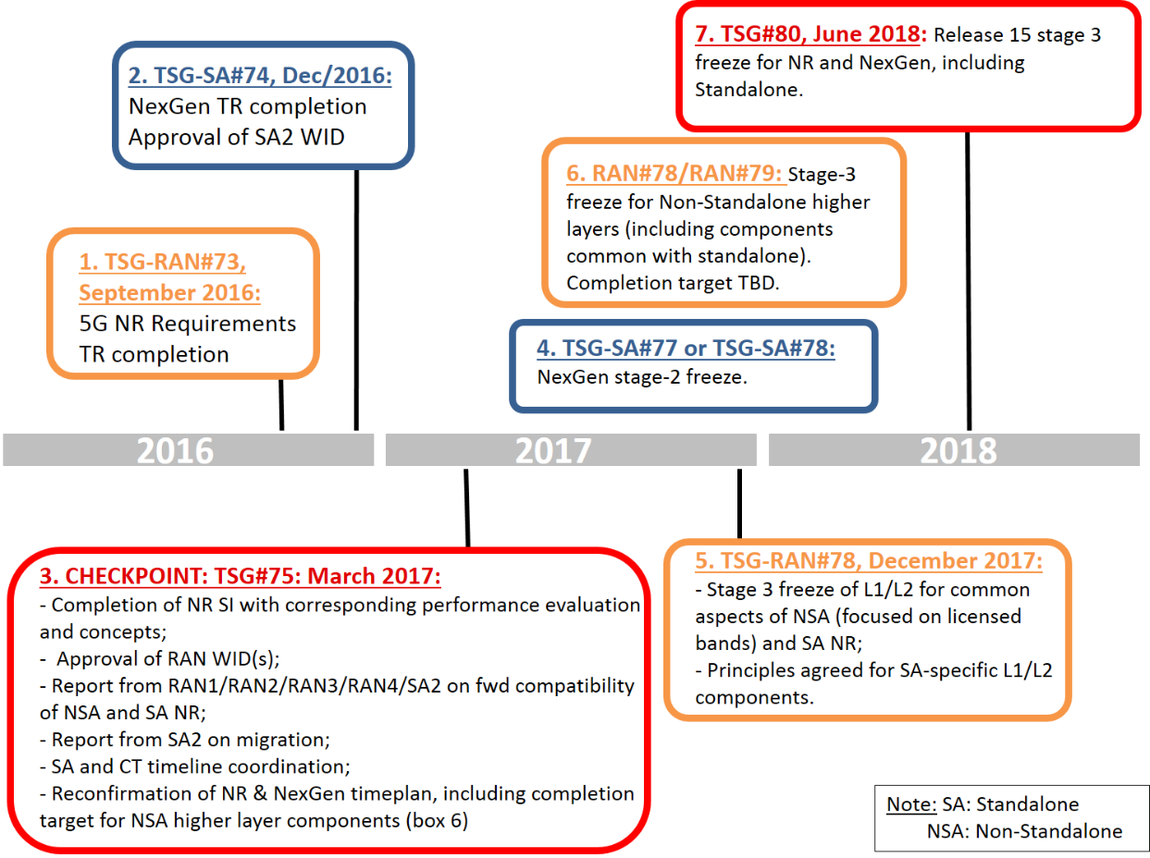
The 5G train left station and running fast..
Key takeaways
3GPP will specify:
A “Phase 1” release of specifications sufficient to enable early 5G launch in 2018
(Release 15)
A “Phase 2” release of specifications containing a complete 5G system description to enable 5G launch in 2020 (Release 16)

Slide 21
Next?
Completion of 5G Phase 1 (Rel15)
  Scheduled for June 2018
Agree contents of 5G Phase 2 Rel16)
  Studies already underway
  Definitive plans and priorities to be set
Continue to work with different industry sectors and encourage their active participation in standards setting
Release 16 will be the beginning of 5G, not the end!

Slide 22

How?

Slide 23
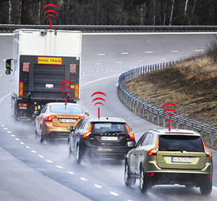
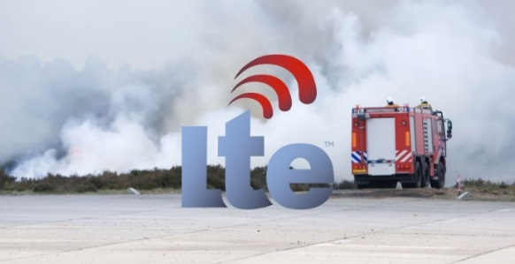
3GPP pre-5G activities
Already in Release 13, features completed that are addressing 5G objectives. More will follow in Release 14 :
Examples (Radio)
  Proximity Services Enhancement (13, 14)
  Internet of Things RATs (NB-IoT, enhanced LTE, EC-GSM-IoT) (13)
  LTE Carrier Aggregation Enhancement (13, 14)
  Support for V2V services based on LTE sidelink (14)
  Ongoing further enhancement of LTE and eMBMS (13, 14)
Examples (System)
  Cellular Internet of Things System Enhancements (13)
  Dedicated Core Networks (13), Enhanced Dedicated Core Networks (14)
  User Plane and Control Plane Separation (14)
  Support for Virtual Network Function (Management and Operation) (14)
  Broadband Mission Critical applications – Video and Data (14)

Slide 24
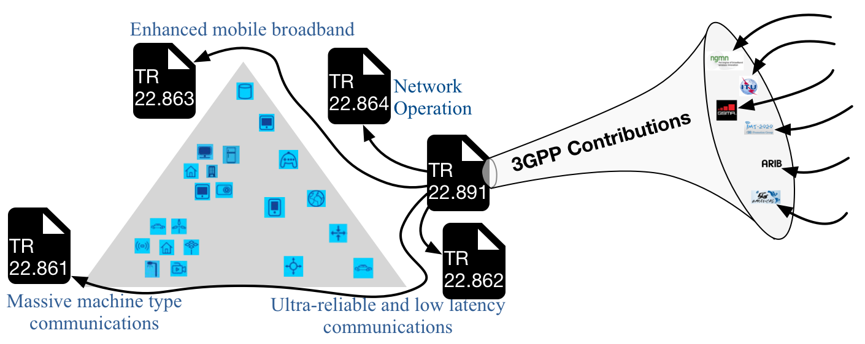
5G requirements capturing in 3GPP
Stage 1 ‘SMARTER‘ studies on
Services and Markets
Technology Enablers
Studies contain
• Use Cases
• Scenarios
• Potential Requirements
All studies complete June 2016

Slide 25


Barriers to success - Conclusion
For 5G to be successful, the telco industry must engage with other industry sectors such as transport, healthcare, mining and exploration, utilities, agriculture, aviation (drones), entertainment, factory automation, etc.
We cannot expect them to come to us, we must be prepared to go to them and to meet them on level terms
ICT Standards bodies must engage with Standards Bodies from other sectors
Within each Government, 5G must be coordinated across all ministries (e.g., transport, health, industry etc) and not just within a communications or ICT ministry
  5G HLF among three ministries is a good beginning

Slide 26
Contact Details:
Dinesh Chand Sharma (Seconded European Standardization Expert in India)
Director – Standardization & Public Policy
SESEI C/O EBTC, DLTA Complex, Gate No 3, 1st Floor, 1, Africa Avenue, New Delhi 110029
Mobile: +91 9810079461, Tel: +91 11 3352 1525, dinesh.chand.sharma@sesei.eu
www.sesei.eu ⬄ www.sesei.in

