Slide 1
'IoT and Smart City Standards and Policies: Global Perspective

Slide 2
Contents
European Project SESEI in India
M2M/IoT
Smart Cities – Europe
  Policy, Research & Standardisation
Smart Cities – India
  Status Update
Digital Infrastructure
  Challenges
Conclusion

Slide 3
European Project SESEI in India

Slide 4
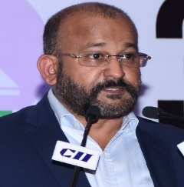






Project is a permanent presence in India
    SESEI (Seconded European Standardization Expert in India) is a local face for the European standardization community in India: Dinesh Chand Sharma
Why SESEI: India is a major trade partners for Europe, Increasing role of standards to gain market access and Evolving & complex nature of regulatory and standardization landscapes, Sharing best practices, work together
Sector: 1. ICT: M2M/IoT, Security, 5G, NFV/SDN, e-Accesibility, eHealth, eCALL… 2. Electrical equipment including Consumer Electronics: Smart Grid, Smart Meter, LVDC, Micro- Grid, Lift Escalator… 3. Automotive: Connected Cars, ITS, e-Mobility… 4. Smart Cities: Mobility, Waste, Energy, ICT..
    www.sesei.eu , www.sesei.in , www.eustandards.in
Notes:
HG

Slide 5
M2M/IoT
Policy, Research and Standardisation

Slide 6
The next step in internet evolution
Pre-
internet
Internet of
CONTENT
Internet of
SERVICES
Internet of
PEOPLE
Internet of
THINGS
“HUMAN
TO
HUMAN”
“SOCIAL
MEDIA”
“MACHINE
TO
MACHINE”
“WWW”
“WEB 2.0”
Fixed &
mobile
telephony
SMS
e-mail
Information
Entertainment
…
e-productivity
e-commerce
…
Skype
Facebook
YouTube
…
Identification, tracking, monitoring, metering, …
Automation, actuation, payment, …
…
+ IP
networks
+ IT platforms
& services
+ devices
& apps
+ sensors,
more devices
& tags,
big data
+ ambient
context,
data
semantics
Source: Alcatel-Lucent
The Internet gave us the opportunity to connect in ways we could never have dreamed possible.
The Internet of Things will take us beyond connection to become part of a living, moving, global nervous system
Notes:
M2M has been around for several decades now
Some deployments date back more than 20 years. However M2M markets are struggling to realise the full M2M market potential
What exactly is Internet of Things : Smart Systems and the Internet of Things are driven by a combination of Sensors & Actuators, Connectivity, People & Processes
Trillion Dollar Opportunity - Unlimited possibilities;
Harbor Research – $180 Billion in 2014 will grow to $1 Trillion
IDC forecasts - The worldwide market for IoT solutions will grow from $1.9 trillion in 2013 to $7.1 trillion in 2020
Cisco - $19 trillion forecast for the economic value created by the “Internet of Everything” by 2020
India and China are biggest contributor..

Slide 7
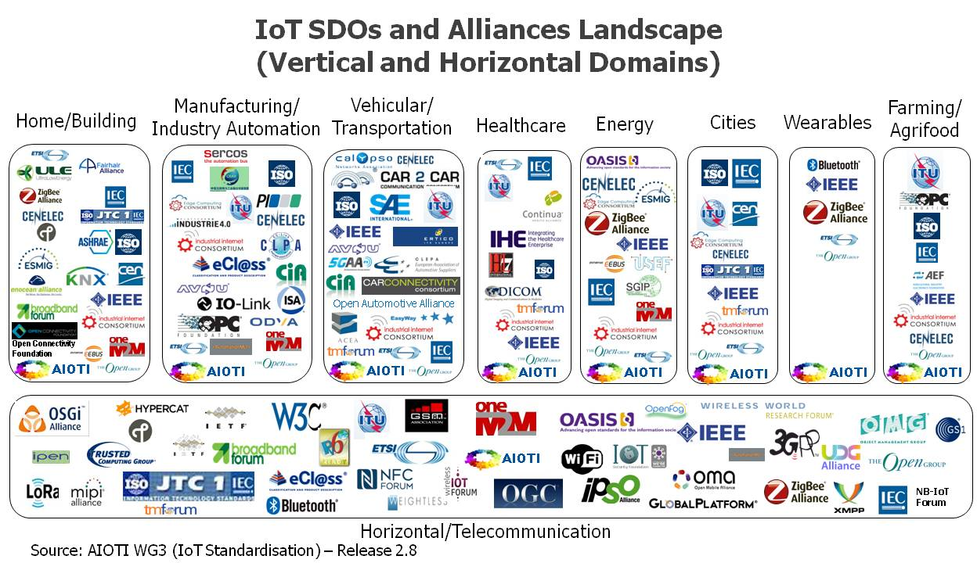

IoT Vertical and Horizontal Domains

Slide 8
ETSI Specialist Tasks Force STF 505 - IoT
The European Commission runs the EU Research and Innovation program Horizon 2020. It supports the emergence of an eco-system capable of delivering the Internet of Things with actions like
  Validation of IoT technologies and approaches through Large Scale innovation Pilots (LSPs);
  Identification of required standards in support of global deployments and interoperability in order to support the LSPs
  ➔ For this purpose ETSI has been tasked to provide two reports on
  “IoT Standards Landscaping“ and “IoT European LSP gap analysis“;
  ETSI TC SmartM2M launched a Specialist Task Force (STF505) to
  proceed this task

Slide 9

ETSI TR 103375 and TR 103376 published
Identifying technical standards/ societal/business gaps as a good indication of the level of maturity of standardization in a given vertical domain
Analysing the standards landscape provides a list of existing standardised technology suggested for reuse by the LSPs
http://www.etsi.org/deliver/etsi_tr/103300_103399/103375/01.01.01_60/tr_103375v010101p.pdf
http://www.etsi.org/deliver/etsi_tr/103300_103399/103376/01.01.01_60/tr_103376v010101p.pdf

Slide 10
















oneM2M Partnership Project
Over 200 member organizations in oneM2M
www.oneM2M.org
All documents are publicly available
Source: oneM2M
10
9
© ETSI 2017. All rights reserved
Notes:
oneM2M is a global partnership project, between 8 of the world’s leading ICT standards development organizations, 7 other partners (standards development organizations like CEN and CENELEC who have recently joined, or OMA, Broadband Forum, GlobalPlatform etc.)
Over 200 companies have participated in the development of the oneM2M specifications. – a set of 10 specs. Published in January 2015, recently updated in 2016. The specifications are all published by the 8 partner standards bodies, making a common set of IoT/M2M specifications across North America, Europe and Asia.

Slide 11












































200+ members organizations
Some of the 200+ active members of oneM2M
Notes:
This is just a small sample of the type of company that is a member of oneM2M.
NIST is an associate member, this is a category specifically created for government t or regulatory agency that has an interest in the development of oneM2M standards.

Slide 12










Ongoing oneM2M collaborations
Guideines
& Ref. Arch.
P2413
collaborations
MQTT
uses
interworks with
Interoperability standards
OMADM LWM2M
Uses/interworks
uses
interworks with
HTTP CoAP TLS DTLS
Protocols
Platforms

Slide 13
Smart Cities - Europe
Policy, Research and Standardisation

Slide 14









EC RnD Projects encouraged to Standardize: H2020 Lighthouse Projects
Notes:
Explored techniques for Replication of Smart City solutions

Slide 15
EC R&D Projects encouraged to Standardize: H2020 Lighthouse Cities (and others)
GrowSmarter: Stockholm, Cologne, Barcelona
mySMARTLife: Nantes, Helsinki, Hamburg
REPLICATE: Bristol, San Sebastian, Firenze
RUGGEDISED: Umeå, Rotterdam, Glasgow
Sharing Cities: London (Greenwich), Lisbon, Milan
SmartEnCity: Vitoria-Gasteiz, Sonderborg, Tartu
SMARTER TOGETHER: Wien, Lyon, München
REMOURBAN: Valladolid, Nottingham, Tepebasi/Eskisehir
Triangulum: Manchester, Eindhoven, Stavanger
www.smartcities-infosystem.eu/sites-projects/projects

Slide 16







EC R&D Projects encouraged to Standardize:
H2020 IoT Large Scale Pilots
Management of Networked IoT Wearables – Very Large Scale Demonstration of Cultural and Security Applications – www.monica-project.eu
ACTivating InnoVative IoT smart living environments for AGEing well - www.activageproject.eu
AUTOmated driving Progressed by Internet Of Things – www.autopilot-project.eu
Internet of Food and Farm 2020 - www.iof2020.eu
Delivering an IoT enabled Digital Single Market for Europe and Beyond – www.synchronicity-iot.eu
User Engagement for Large Scale Pilots in the Internet of Things - www .u4iot.eu
CRoss FErtilisation through AlignmenT, Synchronisation and Exchanges for IoT – www.create-iot.eu
www.european-iot-pilots.eu

Slide 17



Why Standards for Smart Cities ?
Underpinning common understanding
Enabling integration between systems, and between the physical and the digital world
  Accelerating smart city solutions and deployment
  Provide confidence in the market
  Preventing vendor lock-in
  Enabling scaling and replicability of urban solutions
  Facilitating a collaborative, consensus-driven process open to all stakeholders
  Because STD will create Smart Cities!
    … in response to the market and final beneficiaries needs (cities and citizens)
    Mapping of European standards and initiatives relevant to Smart Cities
Notes:
STD can help provide a shared common language and this is critically important because of the wide set of stakeholders involved.
Phy and DIG= cities need reliable and resilient physical and tech infrastructures, working together
One of the most important characteristic of SC is interoperability and coherence between separate systems and services. STD can help define those points of interoperability
The ESOs and their members have an enormous n of std developed in several TCs existing or proposed that are relevant for sc. At the present those TSD broadly concern specific issues rather than dealing with horizontal cross-cutting issues. This is issue is likely to continue since dedicated std are needed for individual applications (transport, healthcare), but a common framework is needed that’s why the CG
Market They can support industrialization of solutions and Speed replicability
- STD can help prevent vendor lock-in = when products and services are built to widely agreed std, it makes it possible to break things down into smaller parts and find the best providers of each of them, rather than having to contract with a single company to offer the whole product.
-STD enabling scale= the use of std ensure cities are following a path taken by many others. Having many cities following a common path will stimulate the market to further support this path and the roll-out of integrated, scalable SC solutions
-STD help to develop and manage a SSCC Strategy and Implementing and managing Smart City projects (align approaches), is the complexityof the city itself and of the (decision-making) processes that need to be put in motion
- Standards are enablers for the seamless integration of city systems, functions, applications and services and for the technologies and communications infrastructures underpinning these.

Slide 18


























































Cities need help in the Specifications Jungle
De Jure SDOs
De Facto SDOs
Promoting
ITU-T
ITU-R
JTC1
SG-20
European ESOs:
CEN
CENELEC
National SDOs:
AIOTI
UK
Japan
...
Open-Source
Notes:
Looking at the general kinds of Standards Developing Organisations
there are three types:
De-Jure: bodies whose specifications are referenced by government contracts and in laws
De-Facto: bodies whose specifications are so widely used that they cannot be avoided,
so called "industry standards"
Promoting: bodies which do not themselves (usually) create specifications,
but do promote certain specifications and guidelines ("profiles")
or do promote the business cases for areas where interoperability is important

Slide 19





Global & EU Standardization activity
ISO/TMB/
Smart Cities SAG + TF
ISO/TC 268 ISO/TC 268/SC 1
IEC SyC
Smart cities
Jointly with IEC and ITU
CEN-CENELEC-ETSI Sector Forum on SSCC
ITU-T/FG
SSC
ISO-IEC/JTC 1 WG 11
Advisory & Strategic Group - ESOs
Technical Committees
Recommendations and coordination
No standardization development
channel EU requirements to relevant TCs
Standardization Development
(Standards, TS, TR, PAS…)

Slide 20
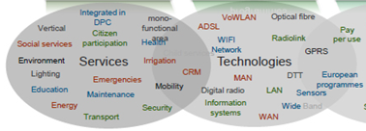
Standards shrink risks in Enabling Technologies
Fixed:
xDSL, Fibre, PoF, PLT, NGN, SDN/NFV, co-axial (cable)
Wireless:
Wi-Fi, Digital Radio, Wide band, narrow band, LTE -> 5G, Satellite, NFC, RFID
Horizontals / Platforms:
Security/privacy, Energy efficiency, M2M, QoS/QoE, Interconnect & Interop, Secure IT platform & data management, semantics, Human Factors

Slide 21
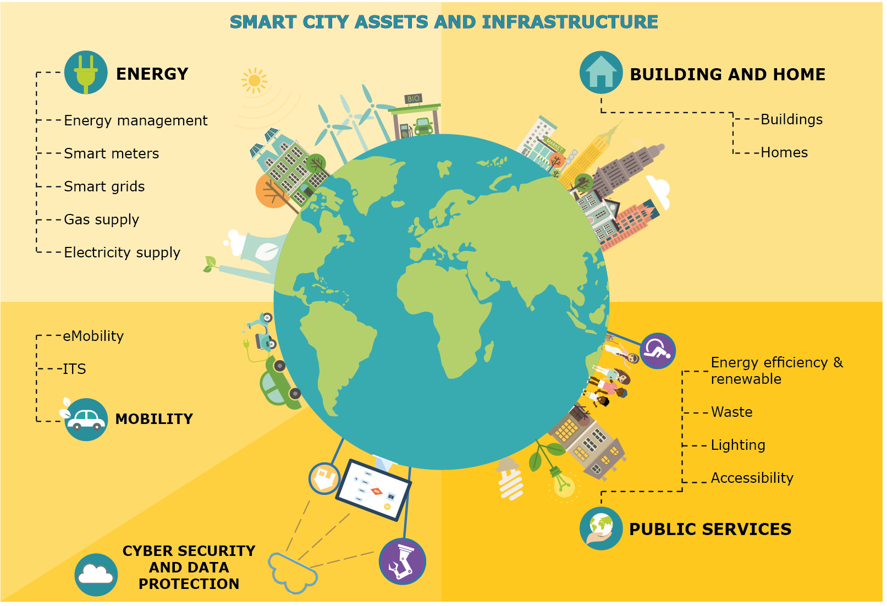
All are looking for similar needs, but stages are different

Slide 22




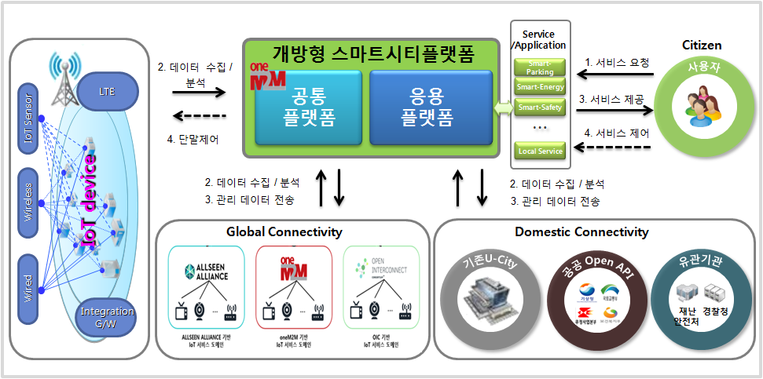








oneM2M based smart city deployment example - Busan
Open Smart City Platform
Service/
Application
Citizen
1
Request services
2
Common
Platform
Application Platform
Smart-Parking
LTE
Smart-Energy
Data collection
/analysis
3
Provide services
Smart-Safety
IoT Sensor
Device control
Service control
4
…
4
Users
Local Service
2
Data collection/analysis
2
Data collection/analysis
Wireless
3
Data transmission
3
Data transmission
Global Connectivity
Domestic Connectivity
U-City
Public Open API
Government
Wired
Integration G/W
AllSeen Alliance-based
IoT service domain
oneM2M-based
IoT service domain
OIC-based
IoT service domain
Source: SKT

Slide 23
Key requirements for smart city IoT platform
Horizontal platform for new deployments
Smart city is an incremental and participatory journey
New deployments should, where possible, leverage a converged networks and an horizontal service platform
Open standards are key to avoid lock-in and master the total cost of ownership
Existing deployments
Do not disrupt existing “vertical deployment” but seek opportunities for an integration path with an horizontal approach
Build value through smash-ups and open data
Participatory and innovative approach
Surveys
Address needs for innovation through app development:
  APIs
  Access to, eventually semantically enriched, Open data (where feasible and subject to privacy legislation/citizen consent)
Security and (device) management are key
Despite initial focus on IoT data, there is an increased interest in security and device management (which go hand in hand).
Need arises from security threat analysis conducted recently: e.g. ”Two researchers analyzed Smart meters widely used in Spain and discovered that can be hacked by attackers to harm the overall National power network.”, source: http://securityaffairs.co/wordpress/29353/security/smart-meters-hacking.html

Slide 24













A possible smart city blue-print
Cloud apps
Dashboards
City Apps
3rd party apps
Analytics apps
Dashboards
City Apps
3rd party apps
Analytics apps
REST
APIs
REST
APIs
SPARQL or
REST APIs
Smart city backend
Open data
(Semantics)
Group mgmt
Data
Mgmt
Cloud
VM Mgmt
Location
Big Data Storage
Big Data enablers
Broker
Other data
sources
I/F to other
IoT platforms
Discovery
Adapter
Existing
deployments
Device
Interworking
Adapter
Smart city frontend
Security
App
App
App
Data center
Device mgmt
Field domain
Gateway
Gateway
Device
D
D
D
D
D
D
D
D
D
LWM2M

Slide 25
Smart Cities - India
Status Update

Slide 26
Selected cities with proposed investments
City Challenge (Year) | Selected Cities | Total cost of projects (bn. euro) | ABD (bn euro) | Pen city solutions (bn euro) | Total urban population impacted (Cr.)
Round 1 (2016) | 20 | 6.02 | 4.65 | 1.37 | 3.74
Fast track (2016) | 13 | 3.73 | 3.25 | 0.48 | 0.94
Round 2 (2016) | 27 | 6.75 | 5.32 | 1.42 | 2.55
Round 3 (2017) | 30 | 7.18 | 5.87 | 1.32 | 2.37
Round 4 (2018) | 99 | 1.6 | 1.33 | 0.27 | 0.35
Total | 99 | 25.28 | 20.42 | 4.86 | 9.95
Total winning proposals – 100=> One more City Shillong (Meghalaya) gets selected as the 100th Smart City
Total Cost of Projects – 25.28 billion euro
Area based development (ABD) investment - 20.42 billion euro
Pan city solutions investment - 4.86 billion euro
Total impacted urban population – 99.5 Million

Slide 27
Projects completed and under progress
According to report released by Ministry of Urban & Housing Affairs (MoUHA):
As on 17th January 2018, 2,948 projects worth Rs. 1,38,730 crore (17.36 billion euro) are in various stages of implementation
  189 projects have been completed
  495 projects projects have started work
  Tenders have been floated for 277 projects and
  1,987 projects are at detailed project report (DPR) stage.

Slide 28
Smart City - Standards
BIS CED 45 drafted Smart City Indicators based on ISO 37120:2014 Sustainable Development of Communities: Indicators for city services and quality of life‘
BIS Panel on ICT New & Emerging Technology
  Panel 2: Title–Smart Infrastructure monitoring and contributing work carried out at ISO & IEC on the topics of Smart Cities (ICT Technology), Active Assisted Living, Smart manufacturing, Smart Energy
NIUA and MoUD have also prepared and released Smart City Indicators that can be used by cities to measure their performance
  45 core indicators and 22 supporting indicators
MoUD with NASSCOMM and DSCI also prepared guindelines for the Security part of Smart Cities

Slide 29
Challenges
  Availability of master plan & retrofitting of existing cities
  Financial sustainability of Urban Local Bodies (ULBs)
  Technical constraints & Multi-tier governance
  Providing clearances in a timely manner
  Dealing with a multivendor environment
  Capacity building
  Reliability of utility services

Slide 30
Digital Infrastructure
Challenges

Slide 31
The world is changing - Digitization
The Challenges:
  changing economy: growing importance of services
  Digital transformation, convergence: Everything is becoming Smart – ICT [IoT]
  Data Privacy and Security
To remain relevant, standards must be timely, market-driven and produced in an inclusive way quickly

Slide 32
What can/should we do?
Awareness, Education and Understanding about the Standardisation System i.e. increasing the use of standards and participation in the process at all levels
  Education About Standardisation
Coordination, Cooperation, Transparency, Inclusiveness, i.e. ensuring adequate, high-quality, user-friendly and timely release standards
  ESOs CGs on Smart Energy, Smart Cities, Accessibility, Mobility etc.
  Joint President Groups
Competitiveness and International dimension, i.e. standards supporting competitiveness in the global markets.
  Yearly Work Program, Roadmap, Participation and Contribution to Research Program (H2020)

Slide 33
Conclusions
Concept of Smart Cities is great but lack of infrastructure & basic amenities are the biggest challenges
In case of Smart Cities standards does exist, they need to stitched, and implemented
Government is driving Smart Cities mission but progress is quite slow
Strong need for Common ICT Architecture, Common Service Layer, Global Standards for the Smart Cities applications
Common Service Layer is important and critical for its implementation as part of Smart Cities & oneM2M is global and interoperable standard
Notes:
2012-05-02
33

Slide 34

Dinesh Chand Sharma
(Seconded European Standardization Expert in India)
Director – Standardization & Public Policy
SESEI C/O EBTC, DLTA Complex, Gate No 3, 1st Floor, 1, Africa Avenue, New Delhi 110029
Mobile: +91 9810079461, Tel: +91 11 3352 1525, dinesh.chand.sharma@sesei.eu
www.sesei.eu ⬄ www.sesei.in

