Slide 1
BIS - Curtain raiser on 'Intelligent Transport Systems'

Slide 2
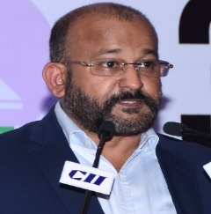






European Project SESEI
    SESEI (Seconded European Standardization Expert in India) is a local face for the European standardization community in India: Dinesh Chand Sharma
Why SESEI: India is a major trade partners for Europe, Increasing role of standards to gain market access and Evolving & complex nature of regulatory and standardization landscapes, Sharing best practices, work together
Sector: 1. ICT: M2M/IoT, Security, 5G, NFV/SDN, e-Accesibility, eHealth, eCALL… 2. Electrical equipment including Consumer Electronics: Smart Grid, Smart Meter, LVDC, Micro- Grid, Lift Escalator… 3. Automotive: Connected Cars, ITS, e-Mobility… 4. Smart Cities: Mobility, Waste, Energy, ICT..
    www.sesei.eu , www.sesei.in , www.eustandards.in
Notes:
HG

Slide 3
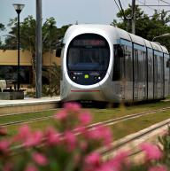



ITS Standards and European Policies
Roadmap to a Single European Transport Area
  Towards a competitive and resource efficient transport system
To meet the challenges, transport has to:
    Use less energy
    Use cleaner energy
    Exploit efficiently a multimodal, integrated and ‘intelligent’ network
Curbing mobility is not an option
By 2050 reduce emissions by 60%, and 20% by 2020 (2008 level)
By 2050 move close to zero fatalities in road transport, halving road casualties by 2020
DAE: "Every Car Digital, Every Car Connected"

Slide 4
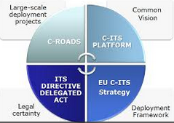
EC Support to Standardisation
Instruments:
Setting of the priorities : ITS Directive legal Framework (2010/40), Radiospectrum Decision 2008/671/EC; Communications (EU-C-ITS Strategy, 5G AP)
  Research Framework program/ H2020/ CIP / C-Roads / PPP
  EC Mandates for standardisation
Groups:
  ITS Committee; ITS Advisory group
  ITS Standardisation Coordination Group
  iMobility Forum
  C-ITS Platform
  EATA, 5GPPP
Support to International Cooperation
Funding of standardisation activities:
  Mandates and ICT Standardisation Rolling Plan
    Specialist Task Forces on EETS
    Specialist Task Forces on coop. systems
    Specialist Task Forces on eCall
    Specialist Task Forces on Urban ITS
  Results from EU funded RTF projects/FOTs/Pilots

Slide 5






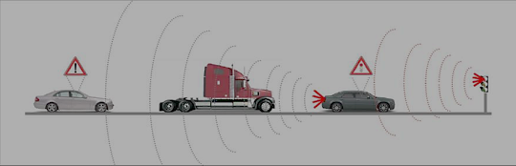

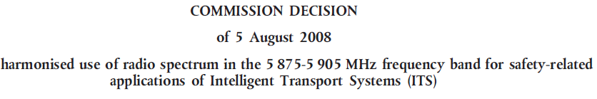
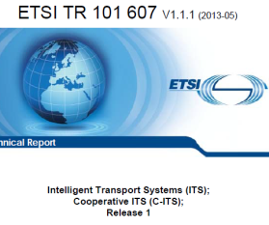


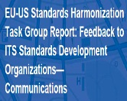
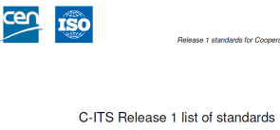


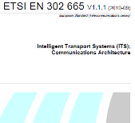















CAVs: Road to Deployment
ITS AP
ITS
Directive
C-ITS
Platform
European ITS
Advisory Group
VSC WG
Report
M/453
Release 1
M/453
F.R.
Rolling
Plan
TC 278
WG16
Rolling
Plan
2
ITSsV6
2002
2003
2004
2005
2006
2007
2008
2009
2010
2011
2012
2013
2014
2015

Slide 6

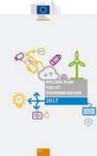
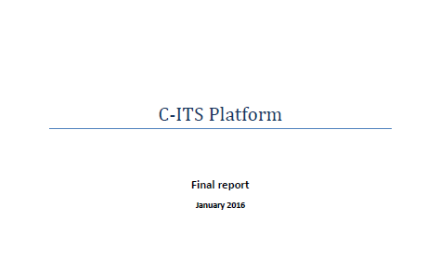


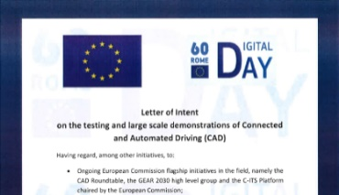


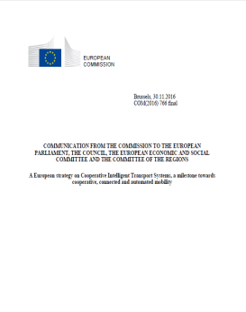



CAVs: Road to Deployment
RSCOM
Mandate
Rolling Plan
Rolling Plan
-V
Rolling Plan
FR Phase I
C-ITS
Platform
FR Phase II
M/ 546
5G EU Corridors
C-ITS
Platform
CEFs Projects
2016
2017
2018
2019
2020

Slide 7








































CAVs standardisation overview
Stakeholders Groups
C-ITS
Platform
ITS Standardisation
Coordination Group
Global
EC
Monitoring
Coordination
M/ 453
AIOTI
M/ 546
Cooperation
2
Cooperation
Results
International
ITSsV6
Validation
& Feedback
European
Cooperation
HTG
EU and national funded projects

Slide 8
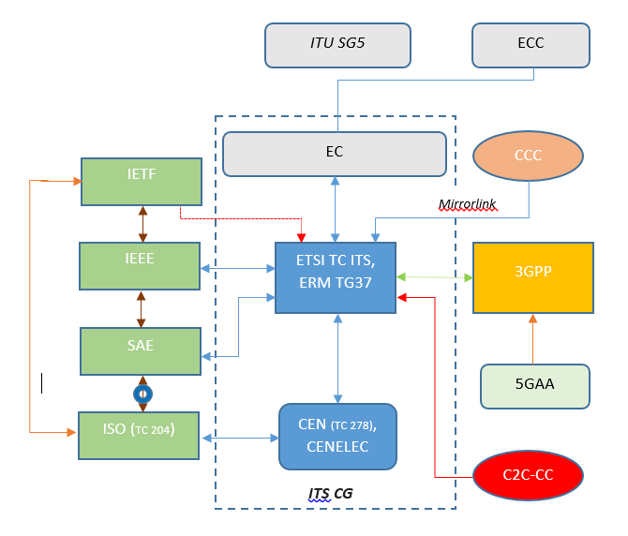

ITS Standardisation world
Coordination and international harmonization of standards with IEEE 802.11 and IEEE 1609 as well as SAE
Coordination with CEN in ITS-CG
Link to the EC via ITS-CG
Link to CCC and C2C-CC
Link to IETF WG IPWAVE (IP Wireless Access in Vehicular Environments)
CCC: Car Connectivity Consortium
C2C-CC: Car 2 Car Communication Consortium
5GAA: 5G Automotive Association

Slide 9



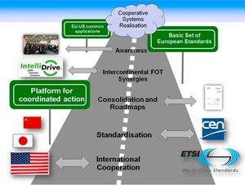
International Cooperation
Global harmonisation of standards for Cooperative Systems
Memorandum of Cooperation agreed between ETSI and U.S. DoT RITA
Harmonization Action Plan process for finalising internationally harmonized standards
Harmonization Principles suggest policies to be followed in the harmonization
Harmonization Task Groups (HTGs):
HTG1: Management and security (complete)
HTG2: Vehicle Safety Message (complete)
HTG3: 5.9GHz protocol harmonization (complete)
HTG4: Roadside messages (under way)
HTG5: Intersection messages (under way)
HTG6: Security Policy (started Jan 2014)
HTG reports issued and being applied by SDOs. Available on EU/US official sites:
  http://www.its.dot.gov/connected_vehicle/international_research.htm
  http://ec.europa.eu/digital-agenda/en/news/progress-and-findings-harmonisation-eu-us-security-and-communications-standards-field
MoC with Japan (MLIT)
      Benefits:
      reducing development costs
      getting to global markets
      avoiding duplication of efforts
      generating economies of scale
Source: COMeSafety2 project

Slide 10
ITS: EU Standards & Specifications
ETSI Application & Facility
RHS/ICRW/LCRW
CAM,DENM, SAEM, P&T…
CEN Application & facility
IVS, CS
IVI, LDM, SPAT, MAP….
ETSI Network/Transport Layer
EN 302 636-4-1 (GN), EN 302 636-5-1 (GTP), EN 302 636-6-1(IPv6 /GN)
ETSI Architecture
EN 302 665, TS 103 175
ETSI Security
TS 102 731
ETSI Access Layer
EN 302 663 (ITS-G5 AL), TS 102 687, TS 102 792, TS 102 724
IEEE MAC-PHY 802.11p
ETSI Test Specs & Plug Tests
CEN Test Specifications

Slide 11
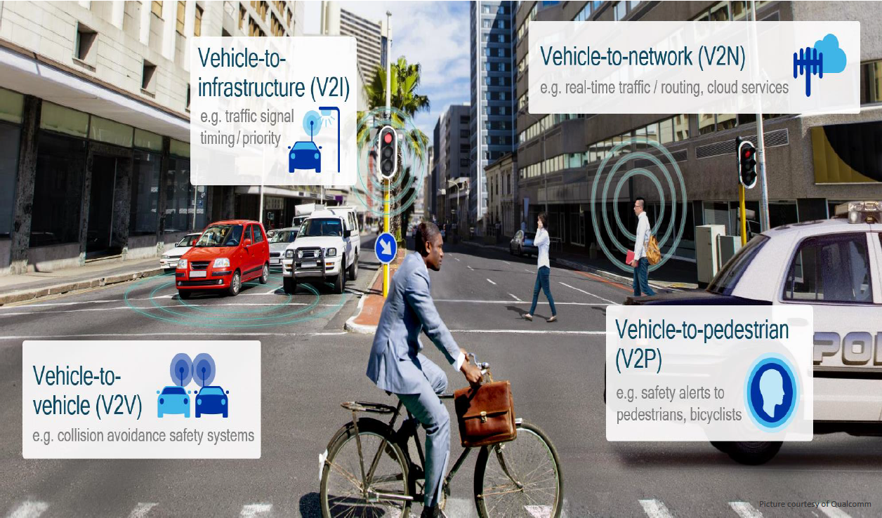
C-V2X Technology

Slide 12
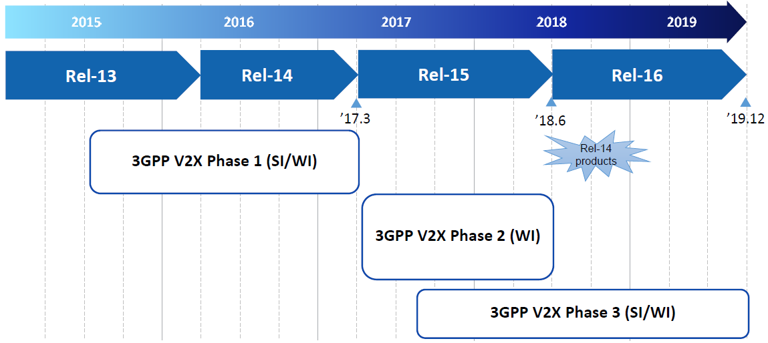
3GPP V2X standardisation timeline
LTE based V2X (Phase 1) specification completed in March 2017
  LTE Uu and PC5 enhancement for enabling V2V and V2X communication
C-V2X standardization ongoing with backward/forward compatibility
  Phase 2 to support 8 carriers aggregation, 64QAM, TX diversity, and latency reduction
  Phase 3 to address advanced use cases and evaluate additional requirements with 5G New Radio (5G-V2X)

Slide 13

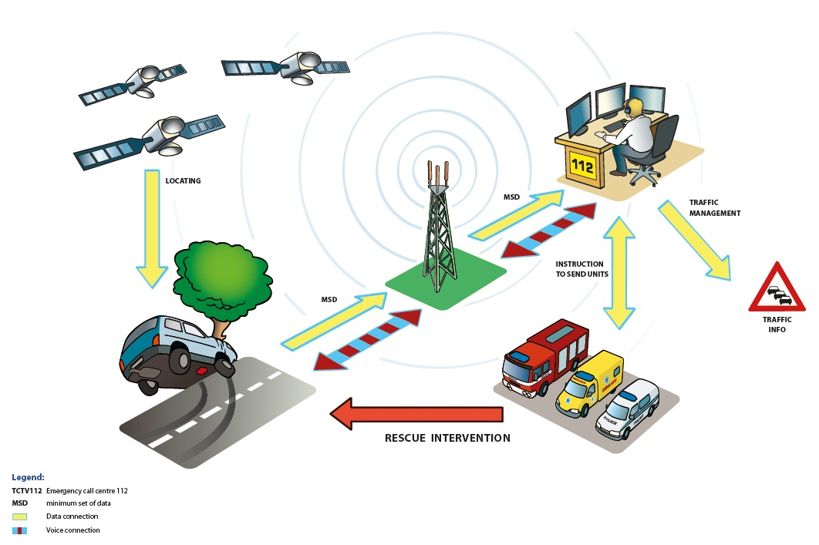
eCall – Emergency Call
eCall is a European initiative intended to bring rapid assistance to motorists involved in a collision anywhere in the European Union.
eCall mandatory in all new cars and light commercial vehicles in the EU from 31st March 2018
eCall is generated either manually by pushing a SOS button or automatically via in-vehicle sensors
eCall car automatically calls the nearest emergency call centre through the 112 to report accident & location.
Minimum Set of Data (MSD) is sent, containing info. regarding the vehicle, its location, direction of travel etc.
eCall will be integrated into up to 20 million new vehicles annually

Slide 14

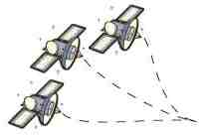
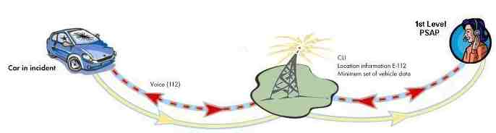
CEN TS/prEN 16454
✓
Public service 112-based only
-Voice + MSD to relevant PSAP
112-based, with or without intermediation platform under Public delegation
eCall end to end conformance testing‏
✓
EN 16072
Pan-European eCall Operating Requirements
ETSI-MSG & 3GPP. Chair: N. Sampson
✓
High Level Application Protocols
EN 16062
✓
✓
ETSI TS 122 101
In-band modem trx
eCall NAD conformance specs:
Voice + MSD on 112
ETSI TS 126 267
✓
✓
“eCall Data Transfer - General Description
ETSI TS 102 936-1
✓
Protocol test specification
EN 15722
✓
✓
ETSI TS 124 008 Table 10.5.135d
ETSI TS 102 936-2
MSD
ETSI TS 126 268
✓
✓
eCall Flag
✓
“eCall Data Transfer. ANSI-C Reference Code
Test Suites
✓
ETSI TR 102 937
✓
eCall Comm. equipment:
Conformance to EU regulations
ETSI TS 126 269
Data registry procedures
- ISO/EN 24978:2009
✓
“eCall Data Transfer. Conformance testing
CEN TC 278 WG 15. Chair Bob Williams
ETSI TR 126 969
EN 16102
✓
“eCall Data Transfer. Characterisation Report
TPS-eCall Operating Requirements

Slide 15
Conclusions
ITS Standardisation is happening at multiple places such as 3GPP, ISO, JTC1, oneM2M, ETSI etc. hence international cooperation, participation is important to get Indian requirement included
ITS rollout based on standards shall ensure safety services for all users
  e-Call is important to be considered for Policy and its implementation based on standards
Wireless Communication will play an important role hence efficient & Technology neutrality of spectrum use is must
In the longer-term of 5G rollout will play a key role for the further development of Connected, Cooperative and Automated Mobility (CCAM) hence active participation in its standardisation is key
Notes:
2012-05-02
15

Slide 16

Dinesh Chand Sharma
(Seconded European Standardization Expert in India)
Director – Standardization & Public Policy
SESEI C/O EBTC, DLTA Complex, Gate No 3, 1st Floor, 1, Africa Avenue, New Delhi 110029
Mobile: +91 9810079461, Tel: +91 11 3352 1525, dinesh.chand.sharma@sesei.eu
www.sesei.eu ⬄ www.sesei.in

