Slide 2
Outline
Who am I?
A brief introduction to standards
Education about Standardization (EaS)
How Standards helps in Economic Development
Conclusion

Slide 3
Project is a permanent presence in India
SESEI (Seconded European Standardization Expert in India) is a face for the European standardization community in India
Why SESEI: India is a major trade partners for Europe, Increasing role of standards to gain market access and Evolving & complex national regulatory and standardization landscapes
Sector: 1. ICT: M2M/IoT, Security, 5G, NFV/SDN, e-Accesibility, eHealth, eCALL… 2. Electrical equipment including Consumer Electronics: Smart Grid, Smart Meter, LVDC, Micro- Grid, Lift Escalator… 3. Automotive: Connected Cars, ITS, e-Mobility… 4. Smart Cities: Mobility, Waste, Energy, ICT..
www.sesei.eu , www.sesei.in , www.eustandards.in
Notes:
HG

Slide 4
Standard?
Standards are simply a way of sharing good practice. It is a document that defines technical or quality requirements with which current or future products, production processes, services or methods may comply
Standards present the consensus view on products/services, managing processes or even improving behaviours.
They can be agreed specifications, recommendations, guidelines or principles.
They demonstrate that products/services meet agreed criteria, processes and principles.
Standards are written & maintained by business/industry, consumers, govt., innovators, etc.
Organizations of all sizes and across all sectors choose standards to help them achieve their goals.

Slide 5
Standards vs Législation
Standards :
Voluntary & Consensual
Developed by independent organisations
Revised every 5 years
Provide specifications and test methods (interoperability, safety, quality, etc.)
Legislation :
Mandatory & Imposed by Law
Established by public authorities
Revised when legislators decide
Gives requirements to protect public interests

Slide 6
How Standards are Made?
All ideas for new standards are assessed & stakeholders are consulted on the potential scope
Anyone can suggest an idea for a new Standard
The Stakeholder group forms a committee to draft the standards
The Proposal is assessed and if approved a stakeholder group is formed
Standards are reviewed every five years some as early as two years from publication. The committee or drafting panel considers any comments they have received about standard and decides whether it needs to be withdrawn , confirmed or reconfirmed amended or revised. A decision to amend or revise the standard will lead to a new proposal for work
Once the document passes final approval it is published
The draft is then issued for public consultation

Slide 7
Integrated with International
Objective - Avoid duplication of work at International and European levels with an aim for a identical worldwide standards
“Vienna Agreement” with
Chemistry, Material, Energy, Environment, Transport, Construction, Services, eMobility etc
Founding member of ISO and working with IEC since 1911
“Frankfurt Agreement” with
Electricity, Electro-technical
MoU for telecommunications sector (ITU-T), Agreement on radio-communication sector (ITU-R)
Founding Partner to 3GPP & oneM2M
DoT/TEC are member of ITU-T and WPC for ITU-R
Information & Communication Technologies (ICT)
Organisational Partner of 3GPP and Partner Type 1 of oneM2M

Slide 8
Education about Standardization (EaS)

Slide 9
Why EaS…
Business needs – increasing competition
New stakeholders – knowledge gap
Research and innovation – marketization
Regulation – understand role of standards & laws
CEN-CENELEC Guide 30 ‘European Guide on Standards and Regulation - Better regulation through the use of voluntary standards - Guidance for policy makers’
Sustainable system – maintain expert base
Hence it is imperative that:
Public authorities and educational and training organizations are aware of need for education about standardization and include relevant content in their curriculam
Raise awareness & spread knowledge about standardization as a powerful tool to bring new technologies to market and drive (future) businesses.

Slide 10
What - EaS
EaS is teaching pupils, students, CEOs, managers, employees in business, and life-long learners the subject of standards and standardization.
It shall include the followings as below:
The use and benefits of standards
the strategic importance of standardization for business and competitiveness
how to implement standards in businesses and
how to participate in standardization to influence the content of future standards.

Slide 11
CEN-CENELEC-ETSI JWG EaS
The Joint Working Group on EaS is between the Three EU Standardization bodies namely CEN,CENELEC & ETSI
JWG-EaS was established as a policy on EaS (2011) with the aims of
improving the understanding of the added value of standardization amongst the key stakeholders (business executives, academia, government and relevant authorities, ...);
increasing the competency of those persons seeking to participate in the standards-making process.
Masterplan on Education about Standardization (2012) to set up a strategy for achieving the vision set out in the Policy on EaS (2011)
Model curricula was developed by JWG-EaS to be used by higher education and vocational training organizations:
model curriculum for higher education (2011)
model curriculum for vocational training (2012)
eLearning tool for SMEs (2015) and repository of teaching tools and materials
Textbook for higher education “A world built on standards” (2015)
Boosting ICT Business and Innovation: A Comprehensive Approach to Standardization Education in Europe

Slide 12
How Standards Benefit in Economic Growth

Slide 13
Standards are important for economic growth?
It is widely accepted that standards play a vital and often invisible role in supporting economic growth:
by promoting productivity and efficiency in companies
through their role in supporting international trade
by acting as a catalyst for innovation within companies and sectors.
Enhance safety of products
Promote common understanding
Facilitate trade by reducing TBs
Promote interoperability of products and services
Benefits of economies of scale
Support environmental sustainability
Facilitate the uptake of innovation & reflect the outcome of research and Development

Slide 14
Boost productivity & improve performance
Increase efficiency by streamlining processes
Reduce cost by minimizing waste & time spent
Lower cost of regulatory compliances
Allows production at scale with standardized solutions, performance or outcomes, thus freeing resources for differentiating products and services from those of competitors
High Quality of Product & Services results in:
buyers' confidence
enhances companies' reputation
Shorten time to market

Slide 15
Kick Starts Innovation
Agree common terminology and transfer new information into the commercial environment, which accelerates the spread of innovation
Support innovators by providing expert, authoritative new knowledge, which in turn becomes a platform for further innovation
Build communities and promote the exchange of knowledge, which catalyzes collaborative development and speeds up technology lifecycles
Encourage process innovation through continual improvement
Enable organizations to unlock their full potential in terms of their products, processes and behaviors

Slide 16
Support Domestic & International Trade
Give buyers confidence that products will be safe and fit for purpose, so they are more widely accepted
Improve transparency – buyers know what they’re getting – which reduces the costs of international trade, such as the need for repeated product testing
Make firms more efficient and innovative, so they can compete globally
Overcome arbitrary national technical barriers to trade
Improve confidence and transparency throughout complex and often multinational supply chains

Slide 17
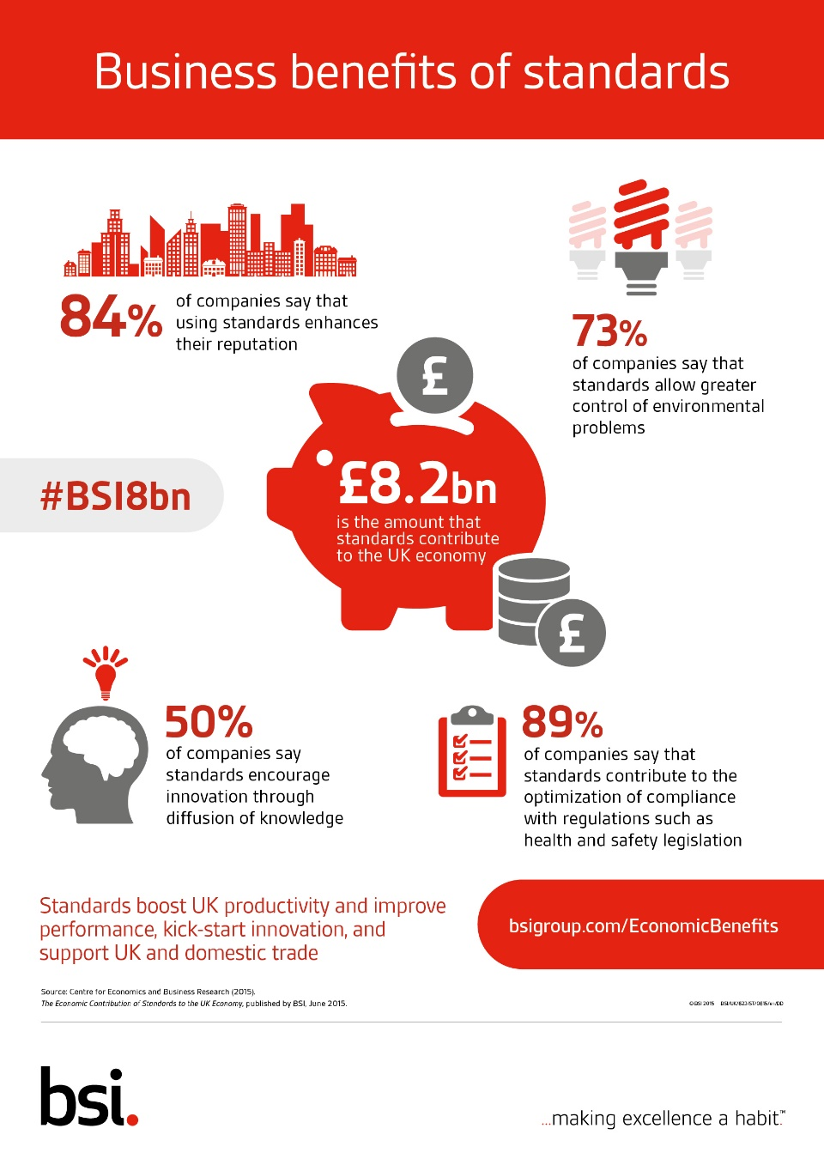
Case Study of UK Economy
Review of Role of Standards from 1921 to 2015 was carried out to provide a comprehensive examination of how standards have impacted UK economic growth:
Standards Contributed worth £8.2 Billion to the UK economy i.e. 28.4 % annual GDP
£ 6.1 billion additional exports per year
37.4% growth in productivity attributed to standards
SMEs are 41% more likely to export if they use standard based products/ services
Large Companies are 36% more likely to export with the adoption of standards
Source : Centre for Economics and ( Cebr) Business Research

Slide 18
Case Study of Nordic Economy
Menon Economics in cooperation with Oxford Research and the Social Science Research Institute of the University of Iceland carried out study - “THE INFLUENCE OF STANDARDS ON THE NORDIC ECONOMIES”
By doubling the stock of standards increase of 10.5 percent in labour productivity across the Nordic countries.
Given the average growth in stock of standards in the Nordic countries of 6.8 percent during the period studied (1976-2014):
Standardization is associated with an annual increase in labour productivity of 0.7 percent per year of a total average growth of 1,8 percent.
This result suggests that standardization is associated with as much as 39 percent of the labour productivity growth and 28 percent of GDP growth in the Nordic countries during the period.
The most important reason for companies to use standards is to improve market access (34 percent of respondents), improve product/service quality (32 percent of respondents) and reduce risk (26 percent of respondents).
Source : Report THE INFLUENCE OF STANDARDS ON THE NORDIC ECONOMIES

Slide 19
Conclusion
Standardisation is a form of self regulation and is a tool to create markets as large and homogenous as possible to allow for economies of scale
Compliance with standards in support of regulation/legislation implies “the right to place a device on the market”, “that is to offer it for sale”
ICT Standards need to be global considering the fact of interoperability
Standards Portfolio Harmonization with Global Standards, raising awareness and visibility plays an important role in strengthening trade
Educational and training organizations must be aware of need for education about standardization and include relevant content in their curricula
Standards helps in Boosting productivity, improve performance, Kick Starts Innovation and help in Domestic & International Trade
Notes:
2012-05-02
19

Slide 20
Dinesh Chand Sharma
(Seconded European Standardization Expert in India)
Director – Standardization & Public Policy
SESEI C/O EBTC, DLTA Complex, Gate No 3, 1st Floor, 1, Africa Avenue, New Delhi 110029
Mobile: +91 9810079461, Tel: +91 11 3352 1525, dinesh.chand.sharma@sesei.eu
www.sesei.eu ⬄ www.sesei.in

