Slide 2

Content
Who am I – EU Project SESEI
M2M/IoT & Smart Cities in Europe
  Policies & Standards Update
M2M/IoT & Smart Cities in India
  Policies & Standards Update
Conclusion
2

Slide 3






Project is a permanent presence in India
    SESEI (Seconded European Standardization Expert in India) is a face for the European standardization community in India
Why SESEI: India is a major trade partners for Europe, Increasing role of standards to gain market access and Evolving & complex national regulatory and standardization landscapes
Sector: 1. ICT: M2M/IoT, Security, 5G, NFV/SDN, e-Accesibility, eHealth, eCALL… 2. Electrical equipment including Consumer Electronics: Smart Grid, Smart Meter, LVDC, Micro- Grid, Lift Escalator… 3. Automotive: Connected Cars, ITS, e-Mobility… 4. Smart Cities: Mobility, Waste, Energy, ICT..
    www.sesei.eu , www.sesei.in , www.eustandards.in
Notes:
HG

Slide 4
M2M/IoT & Smart Cities in Europe
Policies & Standards

Slide 5
M2M/IoT & Smart Cities in Europe
Policies & Standards

Slide 6
The next step in internet evolution
Pre-
internet
Internet of
CONTENT
Internet of
SERVICES
Internet of
PEOPLE
Internet of
THINGS
“HUMAN
TO
HUMAN”
“SOCIAL
MEDIA”
“MACHINE
TO
MACHINE”
“WWW”
“WEB 2.0”
Fixed &
mobile
telephony
SMS
e-mail
Information
Entertainment
…
e-productivity
e-commerce
…
Skype
Facebook
YouTube
…
Identification, tracking, monitoring, metering, …
Automation, actuation, payment, …
…
+ IP
networks
+ IT platforms
& services
+ devices
& apps
+ sensors,
more devices
& tags,
big data
+ ambient
context,
data
semantics
Source: Alcatel-Lucent
The Internet gave us the opportunity to connect in ways we could never have dreamed possible.
The Internet of Things will take us beyond connection to become part of a living, moving, global nervous system
Notes:
M2M has been around for several decades now
Some deployments date back more than 20 years. However M2M markets are struggling to realise the full M2M market potential
What exactly is Internet of Things : Smart Systems and the Internet of Things are driven by a combination of Sensors & Actuators, Connectivity, People & Processes
Trillion Dollar Opportunity - Unlimited possibilities;
Harbor Research – $180 Billion in 2014 will grow to $1 Trillion
IDC forecasts - The worldwide market for IoT solutions will grow from $1.9 trillion in 2013 to $7.1 trillion in 2020
Cisco - $19 trillion forecast for the economic value created by the “Internet of Everything” by 2020
India and China are biggest contributor..

Slide 7
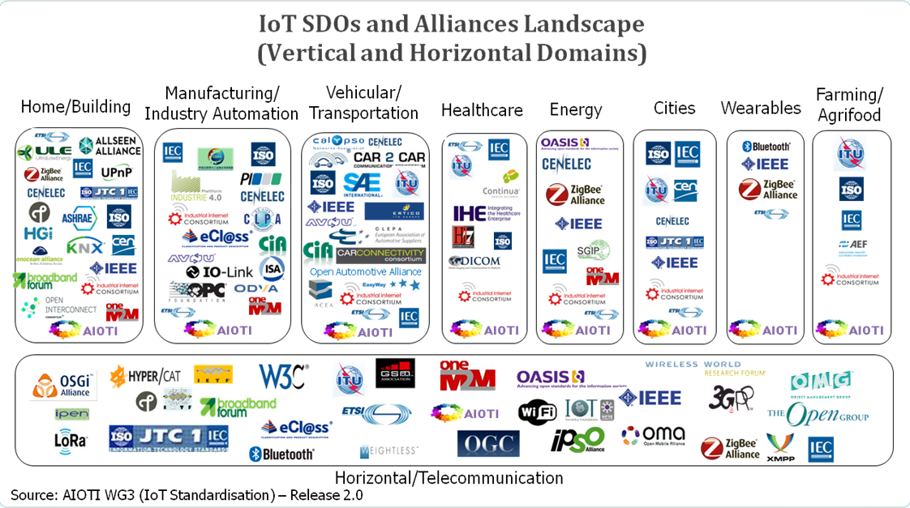
Many related vertical and horizontal activities
Notes:
While IOT/M2M/IOE is a huge topic ranging from last mile connectivity all the way to data models and semantics, One cannot expect the work to focus in a single place. The following list contain few examples, many more exist:
Alljoyn – open source project
ETSI / oneM2M
IEEE P2413—Standard for an Architectural Framework for the Internet of Things, IETF , ISA 100 (Industrial IOT)
ISO/IEC JTC1 /WG7: project named IOT RA covering Sensor Network Reference Atchitecture
ITU Y 2066 and Y2067: Recommendation about IOT covering Requirements and Gateway capabilities
OpenInterconnect , ZigBee, Z-Wave (wireless protocol for home automation)etc.
Key challenges:
Fragmentation, provisioning/efficiency, integration complexity, scalability
M2M Communications meets non-ICT Industry [Automotive, Health, Energy..]
Make intelligent use of information, enabled by connected IT [Cloud..]
SDO/Fora roadmaps are not coordinated, and compete on similar subjects

Slide 8
ETSI Specialist Tasks Force STF 505 - IoT
The European Commission runs the EU Research and Innovation program Horizon 2020. It supports the emergence of an eco-system capable of delivering the Internet of Things with actions like
  Validation of IoT technologies and approaches through Large Scale innovation Pilots (LSPs);
  Identification of required standards in support of global deployments and interoperability in order to support the LSPs
  ➔ For this purpose ETSI has been tasked to provide two reports on
  “IoT Standards Landscaping“ and “IoT European LSP gap analysis“;
  ETSI TC SmartM2M launched a Specialist Task Force (STF505) to
  proceed this task

Slide 9

ETSI TR 103375 and TR 103376 published
Analysing the standards landscape provides a list of existing standardised technology suggested for reuse by the LSPs
Identifying technical standards/ societal/business gaps as a good indication of the level of maturity of standardization in a given vertical domain
http://www.etsi.org/deliver/etsi_tr/103300_103399/103375/01.01.01_60/tr_103375v010101p.pdf
http://www.etsi.org/deliver/etsi_tr/103300_103399/103376/01.01.01_60/tr_103376v010101p.pdf

Slide 10

















oneM2M Partnership Project
Over 200 member organizations in oneM2M
www.oneM2M.org
All documents are publically available
Source: oneM2M
10
9
© ETSI 2017. All rights reserved
Notes:
oneM2M is a global partnership project, between 8 of the world’s leading ICT standards development organizations, 7 other partners (standards development organizations like CEN and CENELEC who have recently joined, or OMA, Broadband Forum, GlobalPlatform etc.)
Over 200 companies have participated in the development of the oneM2M specifications. – a set of 10 specs. Published in January 2015, recently updated in 2016. The specifications are all published by the 8 partner standards bodies, making a common set of IoT/M2M specifications across North America, Europe and Asia.

Slide 11












































200+ members organizations
Some of the 200+ active members of oneM2M
Notes:
This is just a small sample of the type of company that is a member of oneM2M.
NIST is an associate member, this is a category specifically created for government t or regulatory agency that has an interest in the development of oneM2M standards.

Slide 12









Ongoing collaborations
Guidelines
& Ref. Arch.
collaborations
Now OCF
MQTT
uses
interworks with
OMADM LWM2M
Uses/interworks
uses
interworks with
HTTP CoAP TLS DTLS
Protocols
Platforms

Slide 13
M2M/IoT & Smart Cities in Europe
Policies & Standards

Slide 14









EC RnD Projects encouraged to Standardize:
H2020 Lighthouse Projects
Notes:
Explored techniques for Replication of Smart City solutions

Slide 15
EC R&D Projects encouraged to Standardize:
H2020 Lighthouse Cities (and others)
GrowSmarter: Stockholm, Cologne, Barcelona
mySMARTLife: Nantes, Helsinki, Hamburg
REPLICATE: Bristol, San Sebastian, Firenze
RUGGEDISED: Umeå, Rotterdam, Glasgow
Sharing Cities: London (Greenwich), Lisbon, Milan
SmartEnCity: Vitoria-Gasteiz, Sonderborg, Tartu
SMARTER TOGETHER: Wien, Lyon, München
REMOURBAN: Valladolid, Nottingham, Tepebasi/Eskisehir
Triangulum: Manchester, Eindhoven, Stavanger
www.smartcities-infosystem.eu/sites-projects/projects

Slide 16







EC R&D Projects encouraged to Standardize:
H2020 IoT Large Scale Pilots
Management of Networked IoT Wearables – Very Large Scale Demonstration of Cultural and Security Applications – www.monica-project.eu
ACTivating InnoVative IoT smart living environments for AGEing well - www.activageproject.eu
AUTOmated driving Progressed by Internet Of Things – www.autopilot-project.eu
Internet of Food and Farm 2020 - www.iof2020.eu
Delivering an IoT enabled Digital Single Market for Europe and Beyond – www.synchronicity-iot.eu
User Engagement for Large Scale Pilots in the Internet of Things - www .u4iot.eu
CRoss FErtilisation through AlignmenT, Synchronisation and Exchanges for IoT – www.create-iot.eu
www.european-iot-pilots.eu

Slide 17



Why Standards for Smart Cities ?
Underpinning common understanding
Enabling integration between systems, and between the physical and the digital world
  Accelerating smart city solutions and deployment
  Provide confidence in the market
  Preventing vendor lock-in
  Enabling scaling and replicability of urban solutions
  Facilitating a collaborative, consensus-driven process open to all stakeholders
  Because STD will create Smart Cities!
    … in response to the market and final beneficiaries needs (cities and citizens)
Notes:
STD can help provide a shared common language and this is critically important because of the wide set of stakeholders involved.
Phy and DIG= cities need reliable and resilient physical and tech infrastructures, working together
One of the most important characteristic of SC is interoperability and coherence between separate systems and services. STD can help define those points of interoperability
The ESOs and their members have an enormous n of std developed in several TCs existing or proposed that are relevant for sc. At the present those TSD broadly concern specific issues rather than dealing with horizontal cross-cutting issues. This is issue is likely to continue since dedicated std are needed for individual applications (transport, healthcare), but a common framework is needed that’s why the CG
Market They can support industrialization of solutions and Speed replicability
- STD can help prevent vendor lock-in = when products and services are built to widely agreed std, it makes it possible to break things down into smaller parts and find the best providers of each of them, rather than having to contract with a single company to offer the whole product.
-STD enabling scale= the use of std ensure cities are following a path taken by many others. Having many cities following a common path will stimulate the market to further support this path and the roll-out of integrated, scalable SC solutions
-STD help to develop and manage a SSCC Strategy and Implementing and managing Smart City projects (align approaches), is the complexityof the city itself and of the (decision-making) processes that need to be put in motion
- Standards are enablers for the seamless integration of city systems, functions, applications and services and for the technologies and communications infrastructures underpinning these.

Slide 18


























































Cities need help in the Specifications Jungle
De Jure SDOs
De Facto SDOs
Promoting
ITU-T
ITU-R
JTC1
SG-20
European ESOs:
CEN
CENELEC
National SDOs:
AIOTI
UK
Japan
...
Open-Source
Notes:
Looking at the general kinds of Standards Developing Organisations
there are three types:
De-Jure: bodies whose specifications are referenced by government contracts and in laws
De-Facto: bodies whose specifications are so widely used that they cannot be avoided,
so called "industry standards"
Promoting: bodies which do not themselves (usually) create specifications,
but do promote certain specifications and guidelines ("profiles")
or do promote the business cases for areas where interoperability is important

Slide 19





Global & EU Standardization activity
ISO/TMB/
Smart Cities SAG + TF
ISO/TC 268 ISO/TC 268/SC 1
IEC SyC
Smart cities
Jointly with IEC and ITU
CEN-CENELEC-ETSI Sector Forum on SSCC
ITU-T/FG
SSC
ISO-IEC/JTC 1 WG 11
Advisory & Strategic Group of the ESOs
Technical Committees
Recommendations and coordination
No standardization development
Standardization Development
(Standards, TS, TR, PAS…)

Slide 20
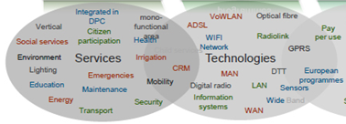
Standards shrink risks in Enabling Technologies
Fixed:
xDSL, Fibre, PoF, PLT, NGN, SDN/NFV, co-axial (cable)
Wireless:
Wi-Fi, Digital Radio, Wide band, narrow band, LTE -> 5G, Satellite, NFC, RFID
Horizontals / Platforms:
Security/privacy, Energy efficiency, M2M, QoS/QoE, Interconnect & Interop, Secure IT platform & data management, semantics, Human Factors

Slide 21
Key requirements for smart city IoT platform
Horizontal platform for new deployments
Smart city is an incremental and participatory journey
New deployments should, where possible, leverage a converged networks and an horizontal service platform
Open standards are key to avoid lock-in and master the total cost of ownership
Existing deployments
Do not disrupt existing “vertical deployment” but seek opportunities for an integration path with an horizontal approach
Build value through smash-ups and open data
Participatory and innovative approach
Surveys
Address needs for innovation through app development:
  APIs
  Access to, eventually semantically enriched, Open data (where feasible and subject to privacy legislation/citizen consent)
Security and (device) management are key
Despite initial focus on IoT data, there is an increased interest in security and device management (which go hand in hand).
Need arises from security threat analysis conducted recently: e.g. ”Two researchers analyzed Smart meters widely used in Spain and discovered that can be hacked by attackers to harm the overall National power network.”, source: http://securityaffairs.co/wordpress/29353/security/smart-meters-hacking.html

Slide 22













A possible smart city blue-print
Cloud apps
Dashboards
City Apps
3rd party apps
Analytics apps
Dashboards
City Apps
3rd party apps
Analytics apps
REST
APIs
REST
APIs
SPARQL or
REST APIs
Smart city backend
Open data
(Semantics)
Group mgmt
Data
Mgmt
Cloud
VM Mgmt
Location
Big Data Storage
Big Data enablers
Broker
Other data
sources
I/F to other
IoT platforms
Discovery
Adapter
Existing
deployments
Device
Interworking
Adapter
Smart city frontend
Security
App
App
App
Data center
Device mgmt
Field domain
Gateway
Gateway
Device
D
D
D
D
D
D
D
D
D
LWM2M

Slide 23
M2M/IoT & Smart Cities in India
Policies & Standards

Slide 24
M2M/IoT & Smart Cities in India
Policies & Standards

Slide 25
M2M/IoT – Projection in India
As per Deloitte's TMT India Predictions 2017, Internet of Things (IoT) is going to be the next big thing for operators as India will rapidly grow into a hub for IoT Solutions.
  The market value of IoT is expected to reach USD 9 billion by 2020.
  IoT units in India is expected to see a rapid growth of 31 times and to reach 1.9 billion by 2020.

Slide 26
M2M/IoT - Updates
DOT released M2M roadmap
  M2M communication standards, Numbering Plan, QoS, Roaming, M2M Service Provider (MSP) registration process, KYC, SIM transfer, Frequency Band, Pilots, Certification, capacity building and Innovation etc.
Meity released its IoT Policy
DoT M2M Service Providers Registration Guidelines
TRAI CP on M2M
  Recommendation awaited
TEC work: Technical Reports
  M2M/ IoT Technical Reports covering Gateway & Architecture, Power Sector, Automotive (Intelligent Transport System) Sector, Remote Health Management, Safety & Surveillance Systems, ICT deployment and strategies for India’s Smart Cities: A Curtain Raiser, Number resource requirement & options, V2V / V2I Radio communication and Embedded SIM, Spectrum requirements for PLC and Low power RF communications, Smart Homes and Communication Technologies

Slide 27
M2M/IoT - Updates
IoT4SCTF working on Smart City RFP models/guidelines
TSDSI work : Technical Reports & Joined oneM2M Partnership Project & 3GPP
  CDOT has developed oneM2M based Common Service Layer
BIS Panel on ICT New & Emerging Technology
  Panel 1: Title–Internet of Things (IoT) Monitoring work carried out at ISO/IEC/JTC1 WG10 covering Internet of Things, Big Data, Sensor network and Wearable devices. Panel work has now been transferred to LITD TC
IET IoT Panel
  Global Advisory Board and Core Panel
  Horizontal: Standards, Legal & Regulatory, Skill Development & Social Impact
  Vertical: Telecom, Energy, Healthcare, Smart living, Smart Transportation and Ganga Rejuvenation
  IET IoT Congress September 14-15th September’2017 in Bangalore

Slide 28
M2M/IoT & Smart Cities in India
Policies & Standards

Slide 29
Smart city Mission-Updates
3 rounds of bidding already concluded
90 Smart Cities identified through extensive selection process
4th round of bidding under progress
Total investment till date up to Rs.1,91,155 cr.
Smart City Mission Report Card by The Urban Development Ministry
City Liveability Index launched by Ministry of Urban Development

Slide 30
Smart City - Standards
BIS CED 45 drafted Smart City Indicators based on ISO 37120:2014 Sustainable Development of Communities: Indicators for city services and quality of life‘
BIS Panel on ICT New & Emerging Technology
  Panel 2: Title–Smart Infrastructure monitoring and contributing work carried out at ISO & IEC on the topics of Smart Cities (ICT Technology), Active Assisted Living, Smart manufacturing, Smart Energy
NIUA and MoUD have also prepared and released Smart City Indicators that can be used by cities to measure their performance
  45 core indicators and 22 supporting indicators
MoUD with NASSCOMM and DSCI also prepared guindelines for the Security part of Smart Cities

Slide 31
Conclusion

Slide 32
Conclusions
Avoid fragmentation, develop together Specification for M2M/IoT/Smart City:
  OneM2M Partnership Project & 3GPP work on IOT
ICT Standards need to be global considering the fact of interoperability
Consensus based Framework for Smart City Architectures
  In case of Smart Cities standards does exist, they need to stitched, and implemented
Common Service Layer is important and critical for its implementation as part of Smart Cities & oneM2M is global and interoperable standard
Project SESEI is here and is working with DoT, MeitY, TEC, TSDSI, BIS, IOT4SCTF, COAI etc..
Notes:
2012-05-02
32

Slide 33
Thank you!
Contact Details:
Dinesh Chand Sharma
(Seconded European Standardization Expert in India)
Director – Standardization, Policy and Regulation
European Business Technology Centre, DLTA Complex, South Block, 1st Floor, 1, Africa Avenue, New Delhi 110029
Mobile: +91 9810079461, Tel: +91 11 3352 1500, dinesh.chand.sharma@sesei.eu
www.sesei.eu

